Slide 1
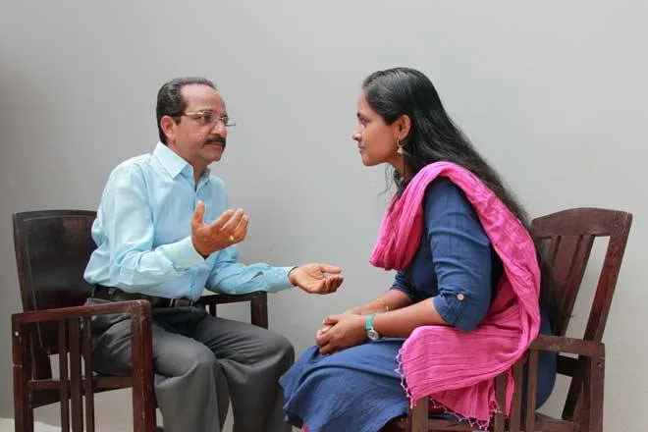
COUNSELING TEENS பதின்ம வயதினருக்கு ஆலோசனை

Slide 2

TRADITIONALISTS –BORN BEFORE 1946
BABY BOOMERS – 1947 – 1964
GEN X – 1965 – 1980
GEN Y - Millennials – 1981 – 1996
GEN Z – 1997 – 2012
GEN α – BORN AFTER 2012

Slide 3

LIFE STYLE OF AN INDIAN TEEN A day in my 11th grade life goes like this
5:55 am : Alarm goes off.
6:00 am: Dad yells and I Wake up .
6:30 am : I get ready and go downstairs
6:45 am : school bus arrives.
8:00 am : I reach school hoping that nothing bad happens and I haven’t failed any of my tests
8:00 to 9:00 am : test.
9:30 am to 4:30 pm: classes. (with 3 breaks in between).
(often classes may go on till 6:30 pm or God forbid 7:30 pm)
I reach home at 6 pm if i have classes till 4:30.
I freshen up, eat and start studying at 8:00 pm for the next test.
But if I feel too tired I might take breaks and use my gadgets.
Nowadays I typically go to bed between 11 pm to 1 am.
I still find it pretty hard to wake up in the morning though.

Slide 4

COMMON COMPLAINTS OF TEENS பொதுவான புகார்கள்

Slide 5

1. Please stop telling relatives about my future. Stop telling them that I don't do housework. Stop telling them that I don't know how to cook. Please STOP
2. I don't want to go to family function. I don't like that. I want some time being alone and being with only me. Please don't force me.
3. If I'm calling a guy for hours or talking to a guy at night it doesn't mean I am in love with him we are just friends stop talking doubt.
4. Stop comparing my marks with other. They go tuition. Or maybe they are more smart than me please stop complaining about my marks.
5. If I have exam next week and I'm still on phone maybe I'm using it for a good purpose or something I need a break from study. STOP saying that I don't study.
6. Stop comparing me with my siblings or with my cousin OK it is good if they are smarter than me but please if I'm not like them stop forcing me to be like ‘em
7. If I don't share my school talks with you it doesn't mean that I'm not comfortable with you there are some things which I don't want to share.
8. If I don't tell you everything it doesn't mean that I have a boyfriend or something like I have failed in an exam or I do something wrong.
9. If I want to go out with my guy friends it doesn't mean that I'll come with a baby in my belly

Slide 6
FAMILY BACKGROUND
1. Family history குடும்ப வரலாறு
2. FAMILY CONFLICT குடும்ப மோதல்
3. Abuse – psychological, verbal, mental துஷ்பிரயோகம
4. Witnessing family violence குடும்ப வன்முறை
5. Appreciation of wrongful deeds தவறான பாராட.டுதல்
6. Discrimination among children பாகுபாடு
7. TV , SOCIAL MEDIA
8. No intimacy நெருக்கமின்மை
9. No fear of God கடவுள் பயமின்மை
10. No teaching of values
11. Fulfilling their own desire
12. Parents’ abuse பெற்றோரின் துஷ்பிரயோகம்

Slide 7

SYNDROME IN TEENS பதின்ம வயதினரின் நோய்குறிகள்

Slide 8

POISONOUS SYNDROMES
PEER GROUP நட்பு வட்டம்
BOYFRIEND-GIRL FRIEND SYNDROME
GADGETS

Slide 9
AGONY OF TEENS
- I CAN’T
-- NO LOVE FROM PARENTS
--CONFIDE SECRETS
- REMEDY FOR MY SIN

Slide 10

Loneliness
தனிமைத்துவம்

Slide 11

CHARACTERS OF LONELINESS தனிமையின் தன்மைகள்

Slide 12

LONELINESS – BODY LANGUAGE தனிமைத்துவம் - உடல் மொழி
TIRED – SLEEPY EYE
HESITATION TO SHARE
HALLUCINATION
SPECIAL ATTRACTION TOWARDS OPPOSITE SEX
TRY TO HIDE FACTS
TOO MUCH NEGATIVE THINKING
NO CONFIDENCE IN OTHERS
BLAME GAME

Slide 13
1. KILLER ATTITUDE கொலையாளி மனப்பான்மை
LONELINESS -- NO ATTACHMENT
1. PARENTS’ SELFISHNESS
2. PARENTS’ COMPARISON WITH SIBLINGS
3. NON-ACCEPTANCE OF PEER
4. NO FREEDOM – EDUCATION, RELIGION, CHOOSING ACCORDING TO SELF DESIRE.
5. PARENTS, SIBLING’S SEX ABUSE
6. LOST VIRGINITY
7. SELF SEXUAL SATISFACTION
8. VALENTINE’S DAY

Slide 14
2. LOW SELF-CONFIDENCE - குறைந்த தன்னம்பிக்கை
RESULT
NEGATIVE THOUGHTS
BLAME GAME IN PEAK
PARENTS ARE ENEMIES
DIFFICULTY IN MAINTAING FRIENDSHIP
THEY WILL NOT ENJOY AND BE HAPPY AND THEY DON’T ALLOW OTHRS TO BE HAPPY

Slide 15

3.DEPRESSION
மனச்சோர்வு

Slide 16

Depression
Depression is a state of low mood and aversion to activity that can affect a person's thoughts, behavior, feelings and physical well-being.
It may include feelings of sadness, anxiety, emptiness, hopelessness, worthlessness, guilt, irritability, or restlessness.

Slide 17

Teenage Depression
Some Basic Facts
பதின்ம வயதினர் மனச்சோர்வு
சில அடிப்படை உண்மைகள்
.

Slide 18
Young people aren't able to verbalize or express their feelings. They may "hint".
The words they choose won't accurately convey their sense of urgency and despair.
The Roots of eating disorders, lie in depression. They are, once again, under that umbrella of chemical imbalance.

Slide 19

4. No parental love
Longing for love –
Counsel & Caution the parents
No one should touch
Keep a distance

Slide 20

5. PEER GROUP
Peer pressure and influence
1. DRUGS
2. BOY FRIEND / GIRL FRIEND
3. IMMORAL ACTIVITIES
4. SAME SEX ACTIVITIES
5. WRONG ATTACHMENTS
6. LOSE FAITH IN PARENTS, TEACHERS AND SIBLINGS

Slide 21

6. Boyfriend/girlfriend syndrome
The Billy Graham Rule:
Should You Be Friends With Someone of the Opposite Sex?
.
It’s OK to have friends of the opposite sex, BUT ………………………

Slide 22

6. Boyfriend/girlfriend syndrome
1a/ First, those friendships should not be close friendships
— the sort of friendships that entail a lot of one-on-one contact or where you’re sharing intimate details of your life with each other.
b/ Friendships with people of the opposite sex should be casual friendships: your time together and, when you do see each other, should not be frequent.

Slide 23
Boyfriend/girlfriend syndrome
2/ Second — and really, this should go without saying — those friendships should be completely out in the open. no secrets and no hiding;
3/ Third, not only should your parents know, your parents should not doubt the friendship

Slide 24

7. ADDICTIONs
Smoking , Drinking, Drugs
PARENTS HAVE NO CONTROL OVER THE CHILD
WRONG PEER GROUP
HERO ATTITUDE
PARENTS FEED WITH UNACCOUNTED MONEY

Slide 25
Thank you

Slide 26

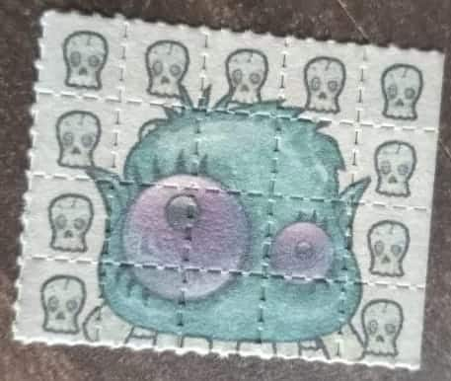
8. DRUGS
LSD (Lysergic acid diethylamide)
LSD STAMP
Methamphetamine (Mental, Behavioral disorders)
Cannabis/marijuana can be used by smoking, vaporizing, within food, or as an extract.

Slide 27

PEOPLE CAN SMOKE MARIJUANA, INHALE IT THROUGH VAPOR, BREW IT AS A TEA, APPLY IT AS A BALM, OR EAT IT IN PRODUCTS, SUCH AS BROWNIES OR CHOCOLATE BARS.
SALVIA – INHALER FOR HALLUCINATION
ROHYPNOL - THESE DRUGS CAN AFFECT YOU VERY QUICKLY AND CAUSE VICTIMS TO BECOME WEAK, CONFUSED, AND EVEN PASS OUT. YOU MAY NOT REMEMBER WHAT HAPPENED WHILE YOU WERE DRUGGED. (KNOWN AS RAPE DRUG)

Slide 28

9. SUICIDE

Slide 29

75,000 students committed suicides in India between
2007 and 2016: Study

Slide 30

Suicide is not a mental illness in itself, but a serious potential consequence of treatable mental disorders
BORDERLINE PERSONALITY DISORDER
A personality disorder characterized by severe mood swings, impulsive behavior, and difficulty forming stable personal relationships.

Slide 31

Basic Counseling Skills அடிப்படை ஆலோசனை திறன்கள்
Deep listening, skillful questions, and goal setting are just three, simple counseling skills that can help you build authentic relationships and contribute to positive outcome with the young people you work with.

Slide 32
Communication serves as the basis for change in counseling. Counselors need to be able to understand and utilize a client’s inner resources and strengths in order to help them move towards their treatment goals.
Engagement is one of the most significant tools that counselors can employ when working with teens who are reluctant about participating in counseling.

Slide 33
1) Deep Listening ஆழமாக கேட்பது
Deep listening is the practice of bringing one’s awareness to the present moment with an attitude of non-judgment—a type of mindfulness practice.
The benefit of this skill is that the teen that’s confiding in you will feel heard, listened to, understood, and as a result your relationship will grow stronger.

Slide 34
Listen and Reflect
Teens want to know they are being heard and understood, you can also ask questions as they talk to ensure you fully understand what they expect from you. Don’t be quick to share without listening to everything they have to say.

Slide 35
2) Skillful Questions திறமையான கேள்விகள்
Asking questions can be a great way to engage teens in lively discussion and help build self-awareness.
Open-Ended Questions
“How are you feeling right now?”
Close-Ended Questions
“Are you feeling upset right now?”
Meaning-Based Questions
“What might that mean?”

Slide 36
Never Judge
A teenager can easily know when you are looking down on them and judging them. If they start to feel like you are judging them, then they will most probably shut down and fear sharing it with other people because they assume they will be judged.

Slide 37
3) Goal setting இலக்கு நிர்ணயம்
Goal setting is a great way to get teens to think about their future. It’s great to get youth to think both about long-term and short-term goals.
Long Term Goals
Encourage him to think about himself as a huge success
Short-Term Goals
Help the teen develop Specific, Measurable, Achievable, Realistic, and Time-bound (SMART) goals.

Slide 38
Activate their family systems
During the counselling, never promise the teen confidentiality. Tell them you will try your best to keep the conversation private but there are some cases like drugs, alcohol, and danger to self that you have to bypass the desire of the teen to have their parents be in the dark.
Having the parents aware that there is a problem can help in providing a solution that you may have not thought of before.

Slide 39
The use of creativity in counseling with teens is encouraged. Creativity can provide venues for teen clients to fully develop and express their thoughts, behaviors, and feelings while becoming empowered.

